Slide 1


WORDPRESS CLIENT
Presented By : GROUP 16

Slide 2
TEAM MEMBER
Nguyễn Văn Giang - 22BI13132 (Leader)
Nguyễn Minh Đức - 22BI13092
Nguyễn Vũ Huy Khôi - 22BI13222
Lưu Anh Đức - 22BI13088
Hà Lê Hoàng - 22BI13170
Nguyễn Hoàng Phương Nam - 22BI13323
Chidi Eze
Olivia Wilson
Aaron Loeb
Cahaya Dewi

Slide 3

1
PROJECT PREVIEW
Overview
Architecture
Implementation
Demo (with emulator)
Conclusion

Slide 4

2
OVERVIEW
Research and API Setup
API Requests
ViewModel Layer
Data Handling with LiveData
UI Observation and Display

Slide 5

3
ARCHITECTURE

Slide 6
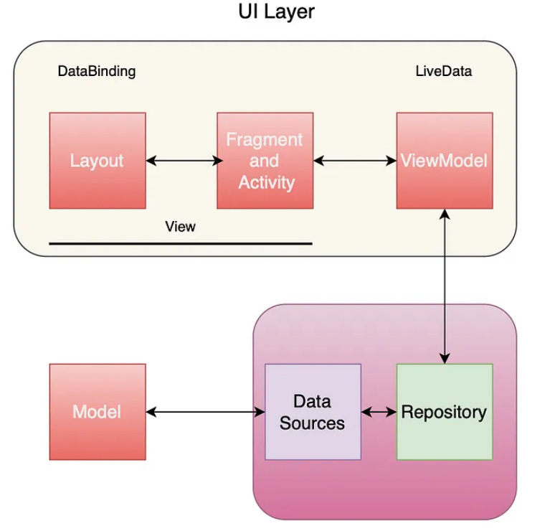
4
ARCHITECTURE
MVVM: Model-View-ViewModel
View:
The structure for a user interface.
Viewmodel:
Efficiently manages Ul-related data within the life-cycle of an application.
Repository:
A storage of functions for manipulating LiveData from Data Sources.
Model
Model classes are non-visual classes that encapsulate the app's data.

Slide 7

5
IMPLEMENTATION
Stimulate Action

Slide 8

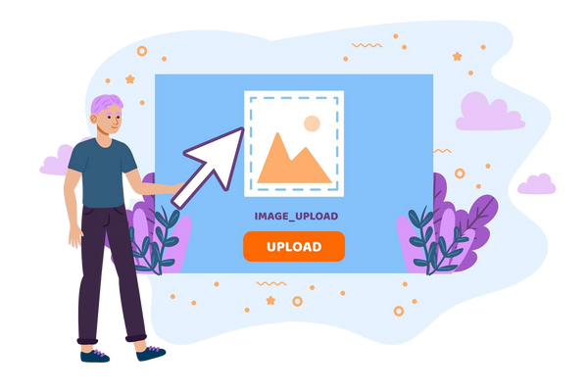


6
IMPLEMENTATION
Oauth2 for authentication
Picasso for displaying image
ViewModels handle data flow
Data
ViewModel
UI

Slide 9
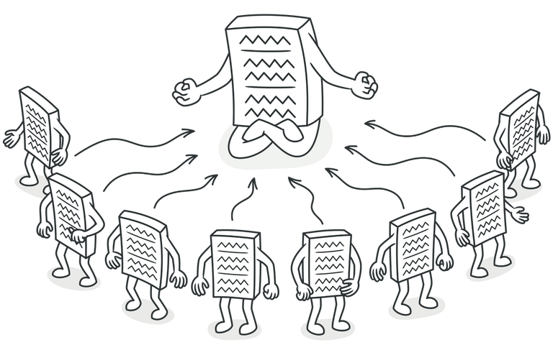
7
IMPLEMENTATION
Retrofit requests for upload media
Recycler View with data observed from ViewModel &LiveData
Volley requests with a singleton Request Queue
Repositories store all API requests

Slide 10

11
CONCLUSION
Stimulate Action

Slide 11

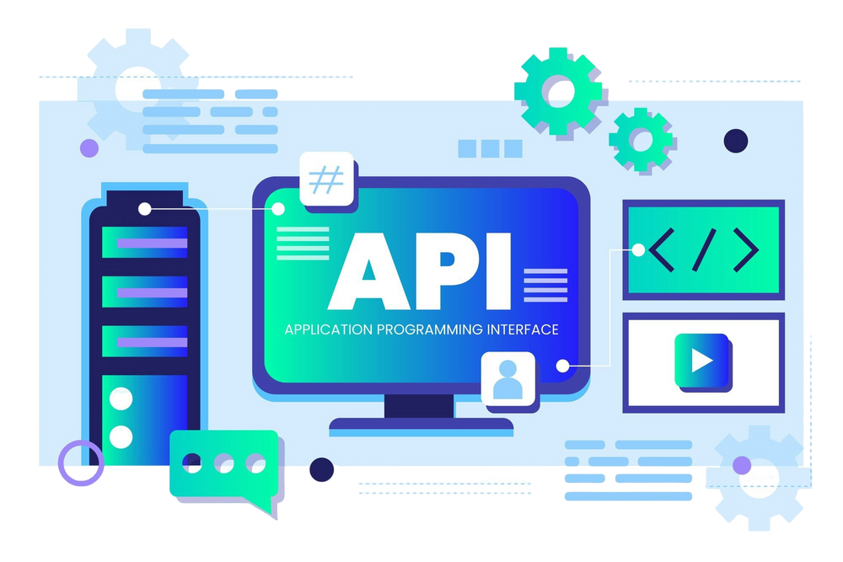
12
ACHIEVEMENTS
Enhanced security measures
Completed API development

Slide 12
THANK YOU

